Slide 1
REVOLUTIONIZING CONSTRUCTION SAFETY: OHS RISK ANALYSIS PROGRAM BASED ON PAST WORKPLACE ACCIDENT DATA DRIVEN BY RANDOM FOREST
By EDAMS COMPANY
(All Rights Reserved)
30.03.2025

Slide 2
1
Content
Introduction & Aim
Methodology
Application & Results
Conclusion and Recommendation
Thanks

Slide 3
2
Workplace Accidents & Construction
Occupational Incidents
Construction Sector Risks
ILO Report
•Construction workers are 3-4 times more likely (developed countries)
3-6 times more likely (developing countries)
to experience fatal accidents
•Short & long term harm (physical or mental), even death
•Unforeseen workplace events - inherent hazards - negligence.
•Lack of full implementation of safety measures by employers/contractors leads to higher accident rates.

Slide 4
3
Aim of the Project
=> Proactively identify potential risks and determine appropriate interventions in the high-risk construction industry.
=> Utilize a dataset of 65,000 work accidents in Turkey by using Machine Learning.
=> Provide a comprehensive risk analysis covering personal and workplace aspects according to genaral risk level & risk levels across different body regions.

Slide 5
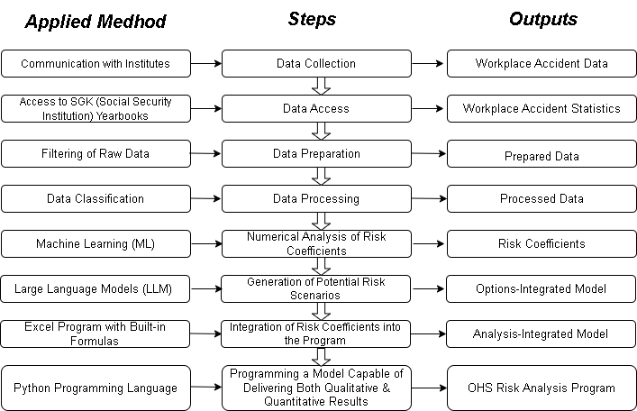

Slide 6
4
Methodolog
Machine Learning (Random Forest)
•Analyzes risk factors with both;
Internal factors: Personal characteristics & conditions
External factors: Work environment - machinery used - injured body regions - injury types
Scenario Analysis for the Workplace Risk Analyse
•Developed from a thorough examination of hazardous machines
•Incorporates nine highest risk scenarios for each machine
•AI Integration with ChatGPT (o3 and o1 models) to increase scenario reliability.
Integration into OHS Risk Analysis Program
•Risk coefficients feed into the program to deliver both quantitative and qualitative results

Slide 7
5
Random Forest & Machine Learning
Machine Learning Overview: Computer algorithm - learn from data - make predictions or - reducing the need for explicit programming.
Random Forest Concept: An ensemble method - combines multiple decision trees - improving accuracy and reducing overfitting
Training Process: Subsets of data - build individual trees - final predictions
Advantages: High predictive power - robustness to noise - built in feature
Applications: classification - regression - risk analysis

Slide 8
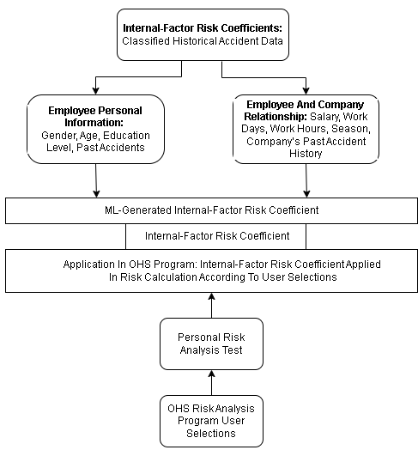
6
Internal Risk Coefficient

Slide 9
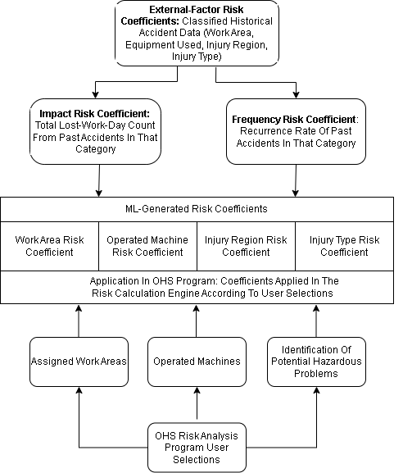
External Risk Coefficient
7

Slide 10
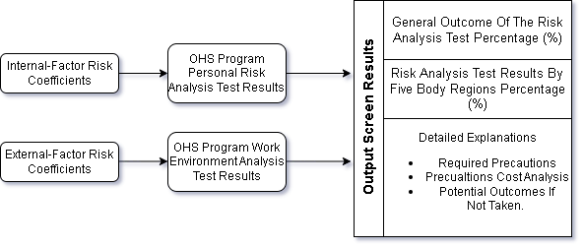
8
Risk Analysis Results

Slide 11
9
Application
The employee who has completed the personal risk analysis test is asked questions about the working environment and the machines he/she uses. (more than one working area and machine can be selected)

Slide 12
10
Result Page for Risk Analysis
General Risk Analysis Results
Visual Risk Analysis

Slide 13
11
Determination of the problems according to user choices and measures to be taken

Slide 14
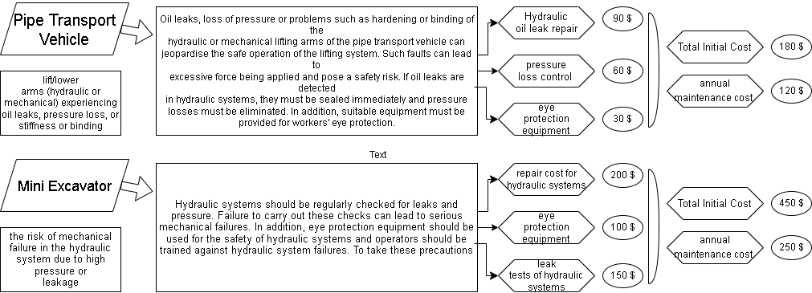
12
Precautions to be Taken and Their Costs
To analyse the cost of the measures that the company should take and the risks that may arise and to create a priority-based cost report

Slide 15
13
Conclusion & Recommendation
Risk Evaluation: Combines both past accident data and generated risk scenarios
Risk Reduction Measures: Detailed explanations on how to reduce identified risks - necessary actions to take - possible consequences by neglecting
Future Expansion: Plans are in place to adapt the application to other sectors, such as industry, transport & storage, and office environments.
Program Advantages: Raise awareness about occupational health - both corporate and individual levels - ultimately reducing accident risks - precautions to be taken and their costs

Slide 16
Çağdaş Aydın: Starter of the EDAMS COMPANY, Yildiz Technical University, Technical University, Faculty of Construction, Department of Civil Engineering, cagdas1999pl@hotmail.com, +90 507 582 03 84, ORCID No: 0009-0002-1310-6907
communications
ANY QUESTION

